Slide 1

Travel vs Geography
PROJECT 3
Cengiz Imga
https://en.wikipedia.org/wiki/Mount_Ararat
https://en.wikipedia.org/wiki/Ishak_Pasha_Palace

Slide 2




Slide 3
EDA
Worked with 1968 rows where ratio is % 50- % 50 for travel and geography subreddits
1: travel , 0: geography
% 46 of the selftext is null (pareto distribution: ‘80-20 rule’; 80 for 0 and 20 for 1)
missing data is filled as ‘unknown’

Slide 4
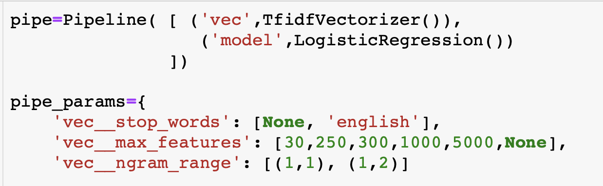
FEATURES
MODELS
Option 1: use only ‘title’ -bad performance
Option 2: ‘title’ + ‘selftext’ -used
1- NAIVE BAYES
MN:MultiNomial
cvec:CountVectorizer
tfvec:TfidfVectorizer
BN:BernoulliNB
GN:GaussianNB
2- SVM (SUPPORT VECTOR MACHINE)
SVC:Support Vector Classification
lin: linear kernel -used
cvec:CountVectorizer
tfvec:TfidfVectorizer
hvec: HashingVectorizer
pol: poly kernel -bad performance
3- LOGISTIC
l2: ridge penalty -used
l1: lasso penalty -bad performance

Slide 5
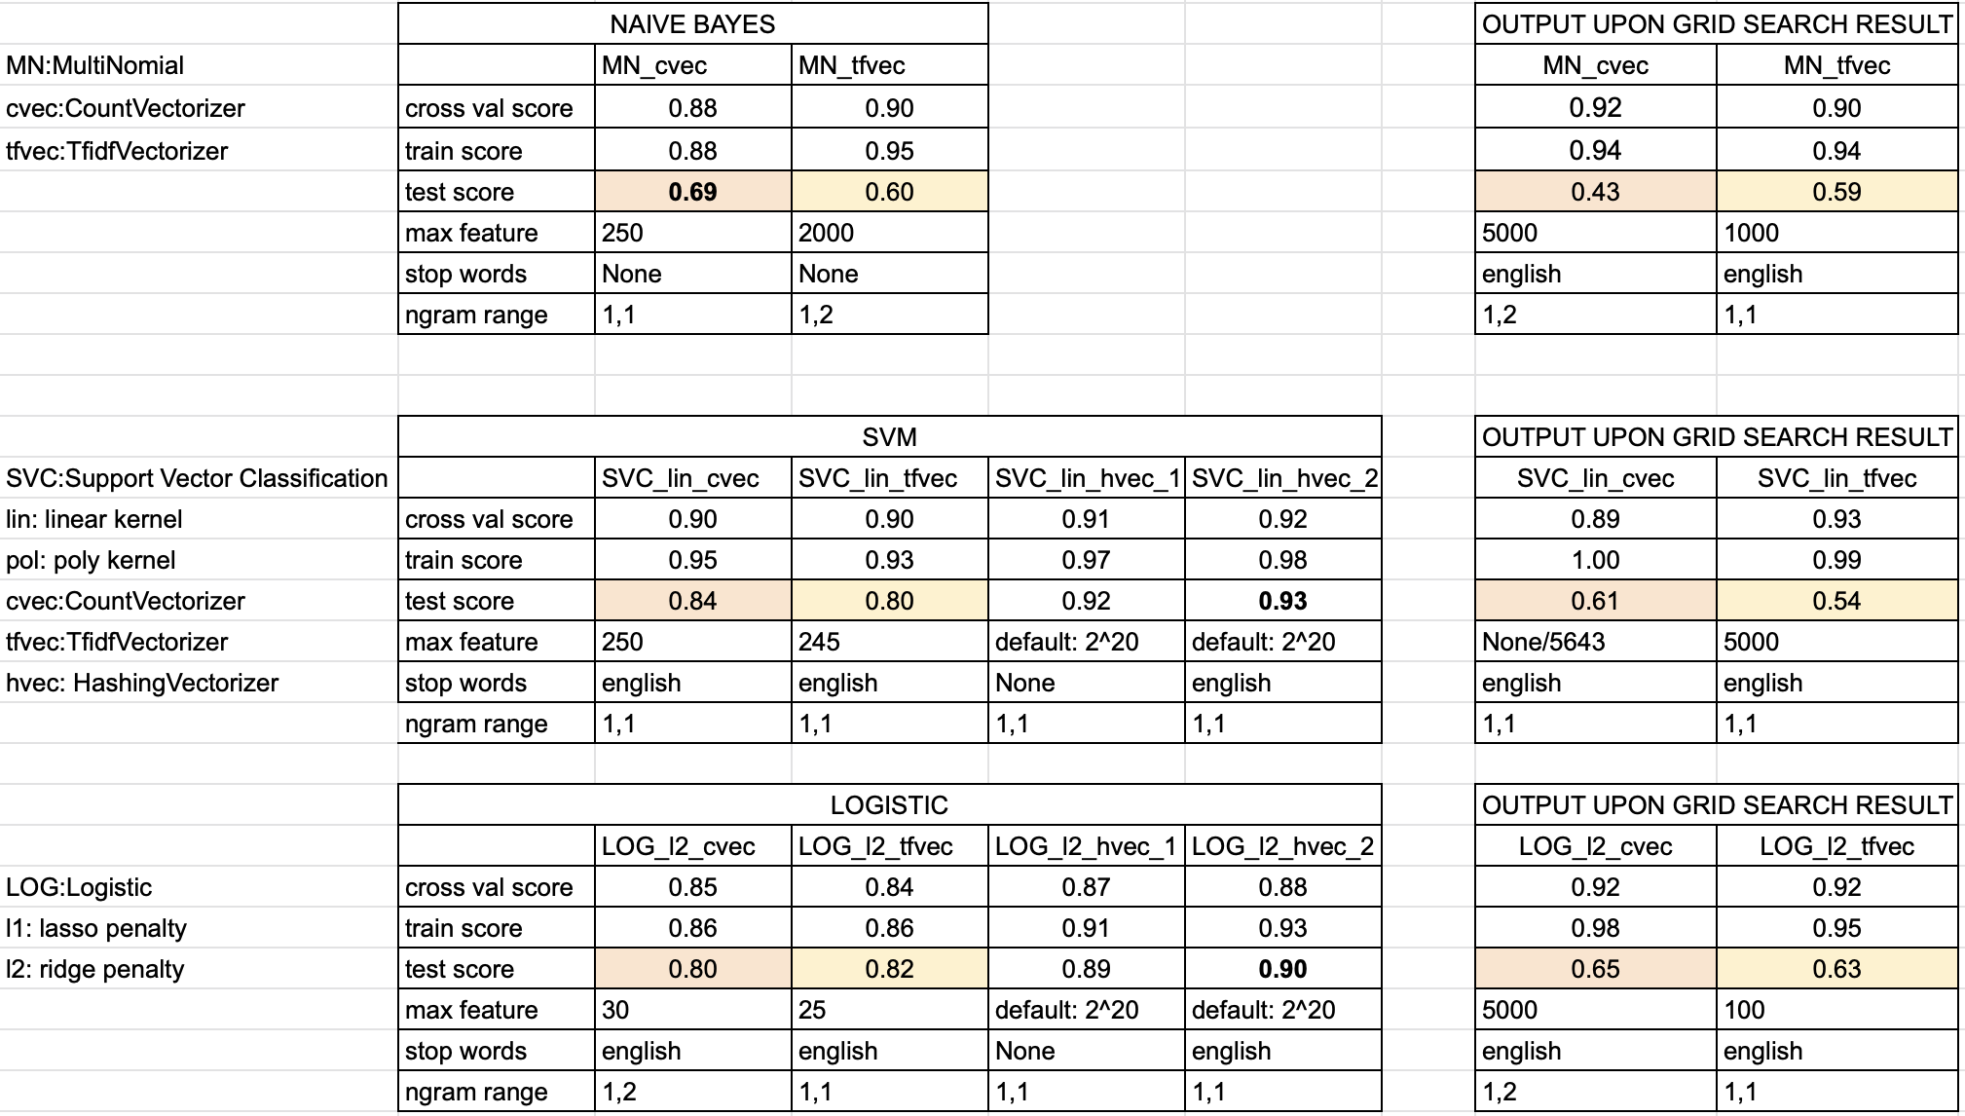
Internally Comparing the Models
Best score of the Grid Search is the cross val score based on the given parameters.
Regarding to output of Grid search Models have high variance and high bias.
The less feature the better result for score as it seems in the table but for HashVectorizing is vice versa.
So you need to play with parameters intuitively and can find better test score relatively.

Slide 6
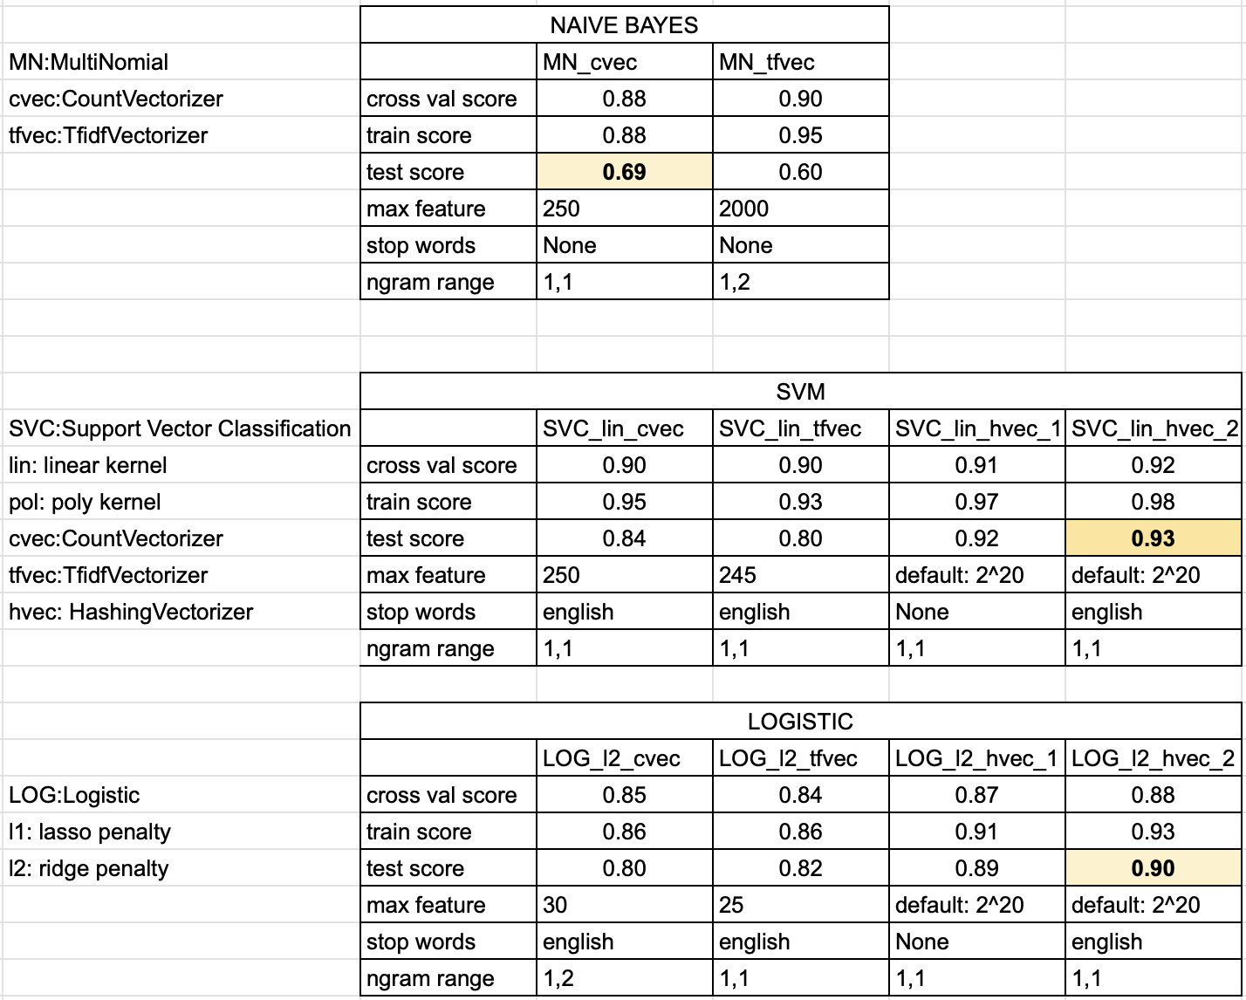
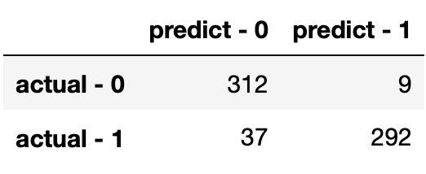
Performance of the Models
SVC gives the best test score. It is not in sweet spot but it is close it.
If we want to avoid from variance then we can choose the LOG model alternatively by conceding 3 points accuracy.
Confusion Matrix

Slide 7
SUMMARY
Give sufficient/right data take right result. Remember title and merged features
High score of cross val means everything is ok ?
Be in doubt if it gives high score like above % 95 . High cross val score doesn’t mean you find the best model.
It may cause of high variance and so useless model. Play with different parameters to find better result
You may go back and update/change main data if needs

